Slide 1
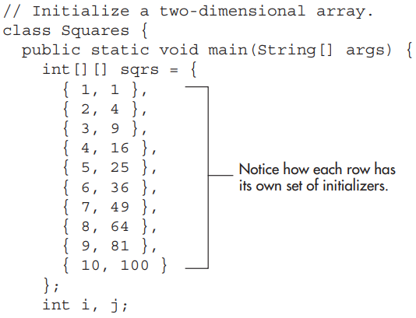
More Data Types and Operators
Example, the following program initializes an array called sqrs with the numbers 1 through 10 and their squares:

Slide 2
More Data Types and Operators

Slide 3
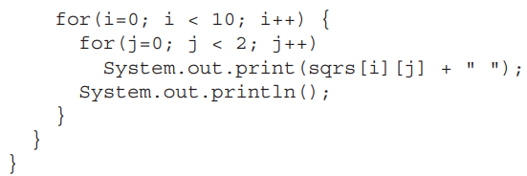
More Data Types and Operators

Slide 4


More Data Types and Operators

Slide 5
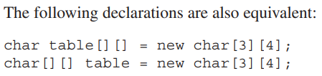
More Data Types and Operators

Slide 6

More Data Types and Operators
when we assign one array reference variable to another, we are simply changing what object that variable refers to.
We are not causing a copy of the array to be made, nor are we causing the contents of one array to be copied to the other.

Slide 7
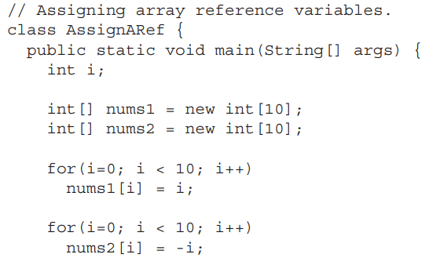
More Data Types and Operators
Example

Slide 8
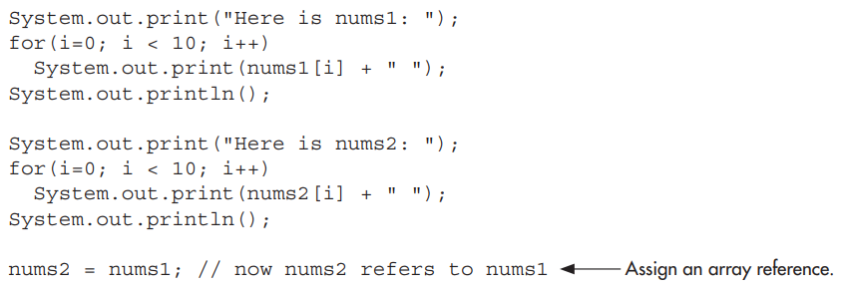
More Data Types and Operators

Slide 9
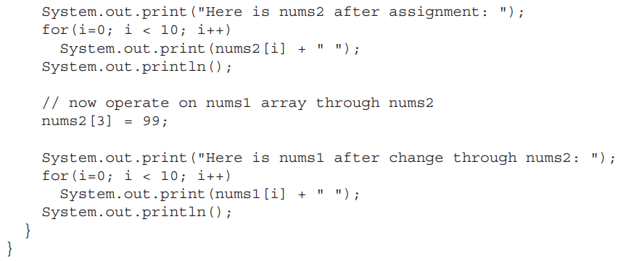
More Data Types and Operators

Slide 10
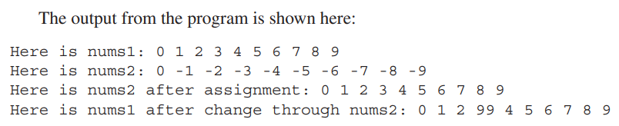
More Data Types and Operators

Slide 11

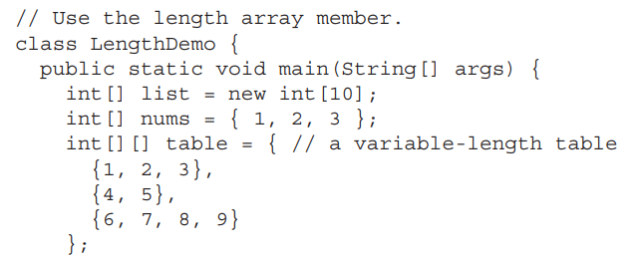
More Data Types and Operators

Slide 12
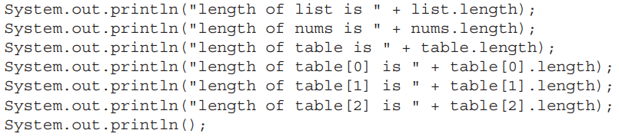
More Data Types and Operators

Slide 13
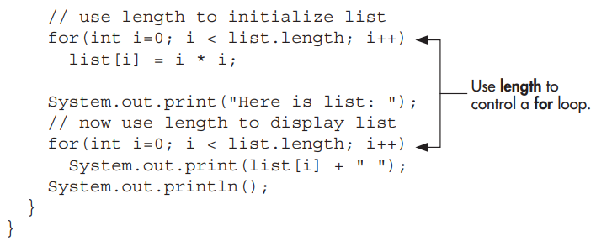
More Data Types and Operators

Slide 14
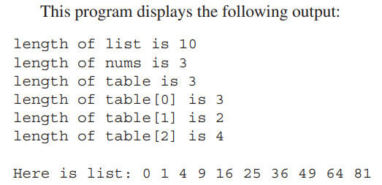
More Data Types and Operators

Slide 15

More Data Types and Operators
When working with arrays, it is common to encounter situations in which each element in an array must be examined, from start to finish.
For example, to compute the sum of the values held in an array, each element in the array must be examined.
The same situation occurs when computing an average, searching for a value, copying an array, and so on.

Slide 16
More Data Types and Operators
Because such “start to finish” operations are so common, Java defines a second form of the for loop that streamlines this operation.
The second form of the for implements a “for-each” style loop. A for-each loop cycles through a collection of objects, such as an array, in strictly sequential fashion, from start to finish.

Slide 17

More Data Types and Operators

Slide 18
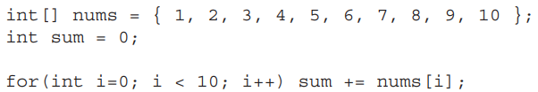
More Data Types and Operators
The following fragment uses a traditional for loop to compute the sum of the values in an array:

Slide 19
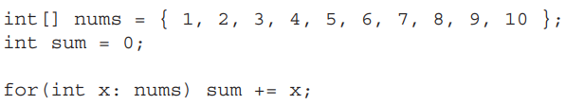
More Data Types and Operators
For example, here is the preceding fragment rewritten using a for-each version of the for:
With each pass through the loop, x is automatically given a value equal to the next element in nums.

Slide 20
More Data Types and Operators
For example, here is the preceding fragment rewritten using a for-each version of the for:
With each pass through the loop, x is automatically given a value equal to the next element in nums.

Slide 21
More Data Types and Operators
Thus, on the first iteration, x contains 1, on the second iteration, x contains 2, and so on. Not only is the syntax streamlined, it also prevents boundary errors.

Slide 22
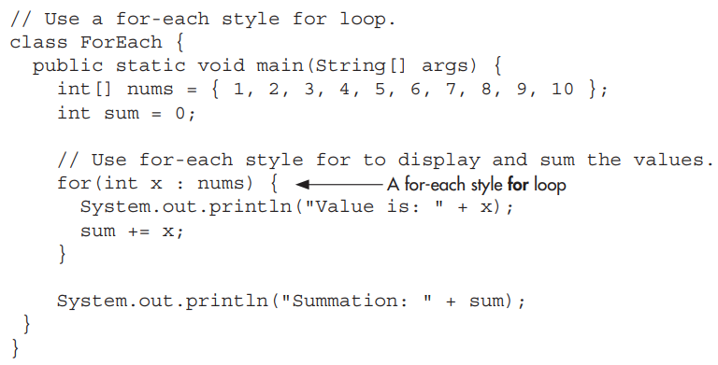
More Data Types and Operators

Slide 23
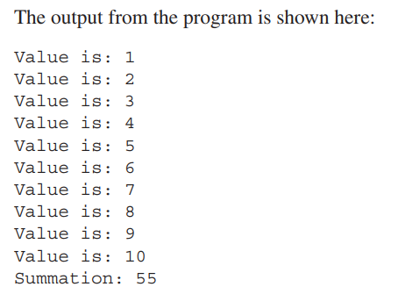
More Data Types and Operators

Slide 24
More Data Types and Operators
Although the for-each for loop iterates until all elements in an array have been examined, it is possible to terminate the loop early by using a break statement.

Slide 25
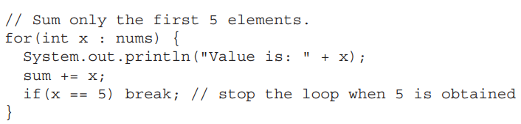
More Data Types and Operators
For example, this loop sums only the first five elements of nums:

Slide 26
More Data Types and Operators
We can’t change the contents of the array by assigning the iteration variable a new value.

Slide 27
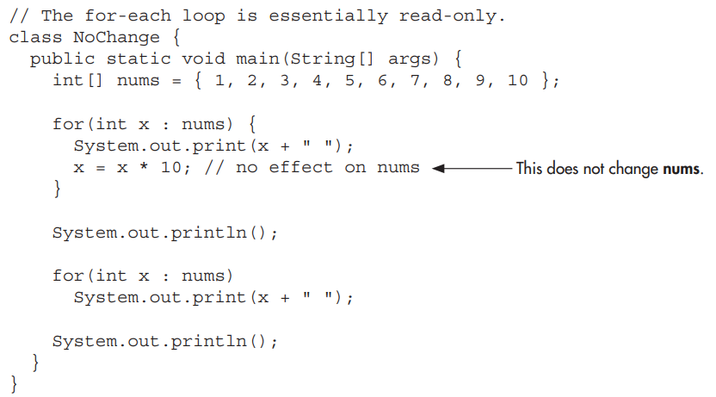
More Data Types and Operators

Slide 28
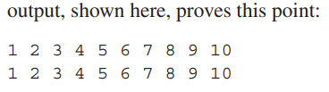
More Data Types and Operators

Slide 29

More Data Types and Operators
String defines and supports character strings.
In some other programming languages, a string is an array of characters. This is not the case with Java.
In Java, strings are objects.
When we create a string literal, you are actually creating a String object.

Slide 30
More Data Types and Operators
For example, in the statement
the string "In Java, strings are objects." is automatically made into a String object by Java.

Slide 31

More Data Types and Operators
we can construct a String just like you construct any other type of object: by using new and calling the String constructor. For example:

Slide 32

More Data Types and Operators
we can also construct a String from another String. For example:

Slide 33

More Data Types and Operators

Slide 34
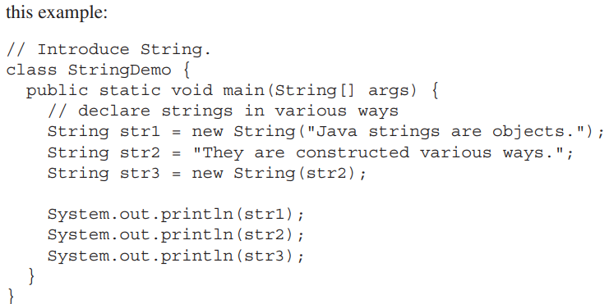
More Data Types and Operators
Once we have created a String object, we can use it anywhere that a quoted string is allowed.

Slide 35
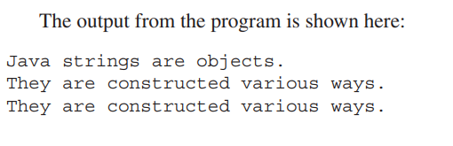
More Data Types and Operators

Slide 36
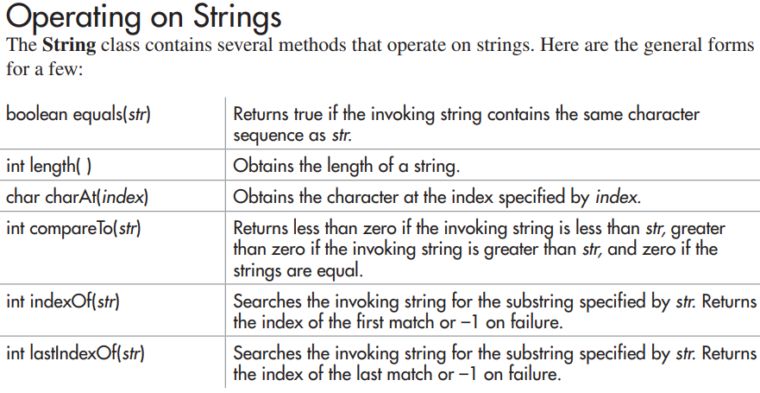
More Data Types and Operators

Slide 37
More Data Types and Operators

Slide 38
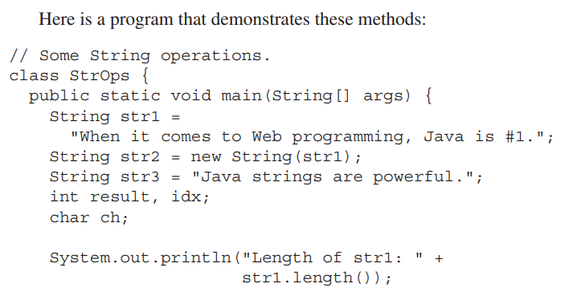
More Data Types and Operators

Slide 39
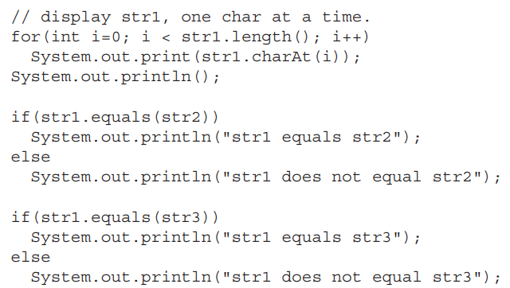
More Data Types and Operators

Slide 40
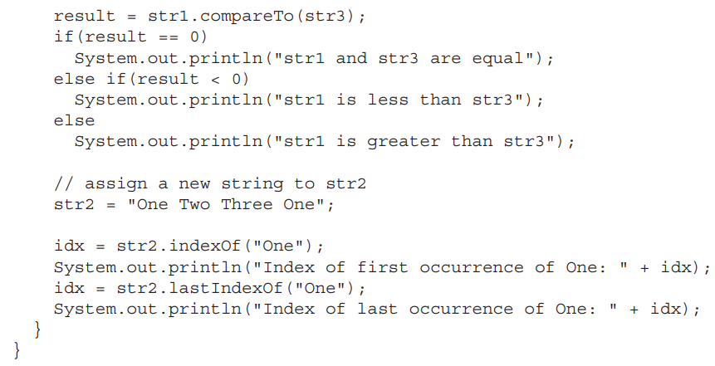
More Data Types and Operators

Slide 41
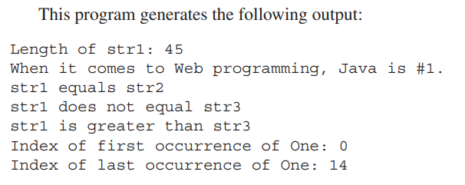
More Data Types and Operators

Slide 42
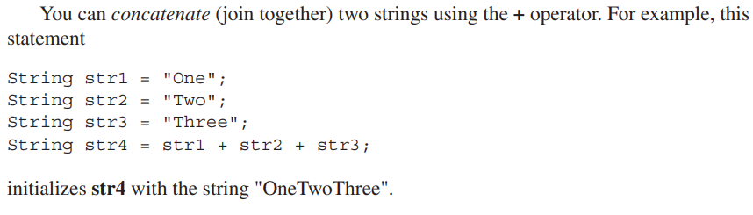
More Data Types and Operators

